Slide 1

K
A wide spectrum TEXTUAL language for modeling and implementation
Bradley Clement, Chris Delp, Klaus Havelund, Rahul Kumar

Slide 2
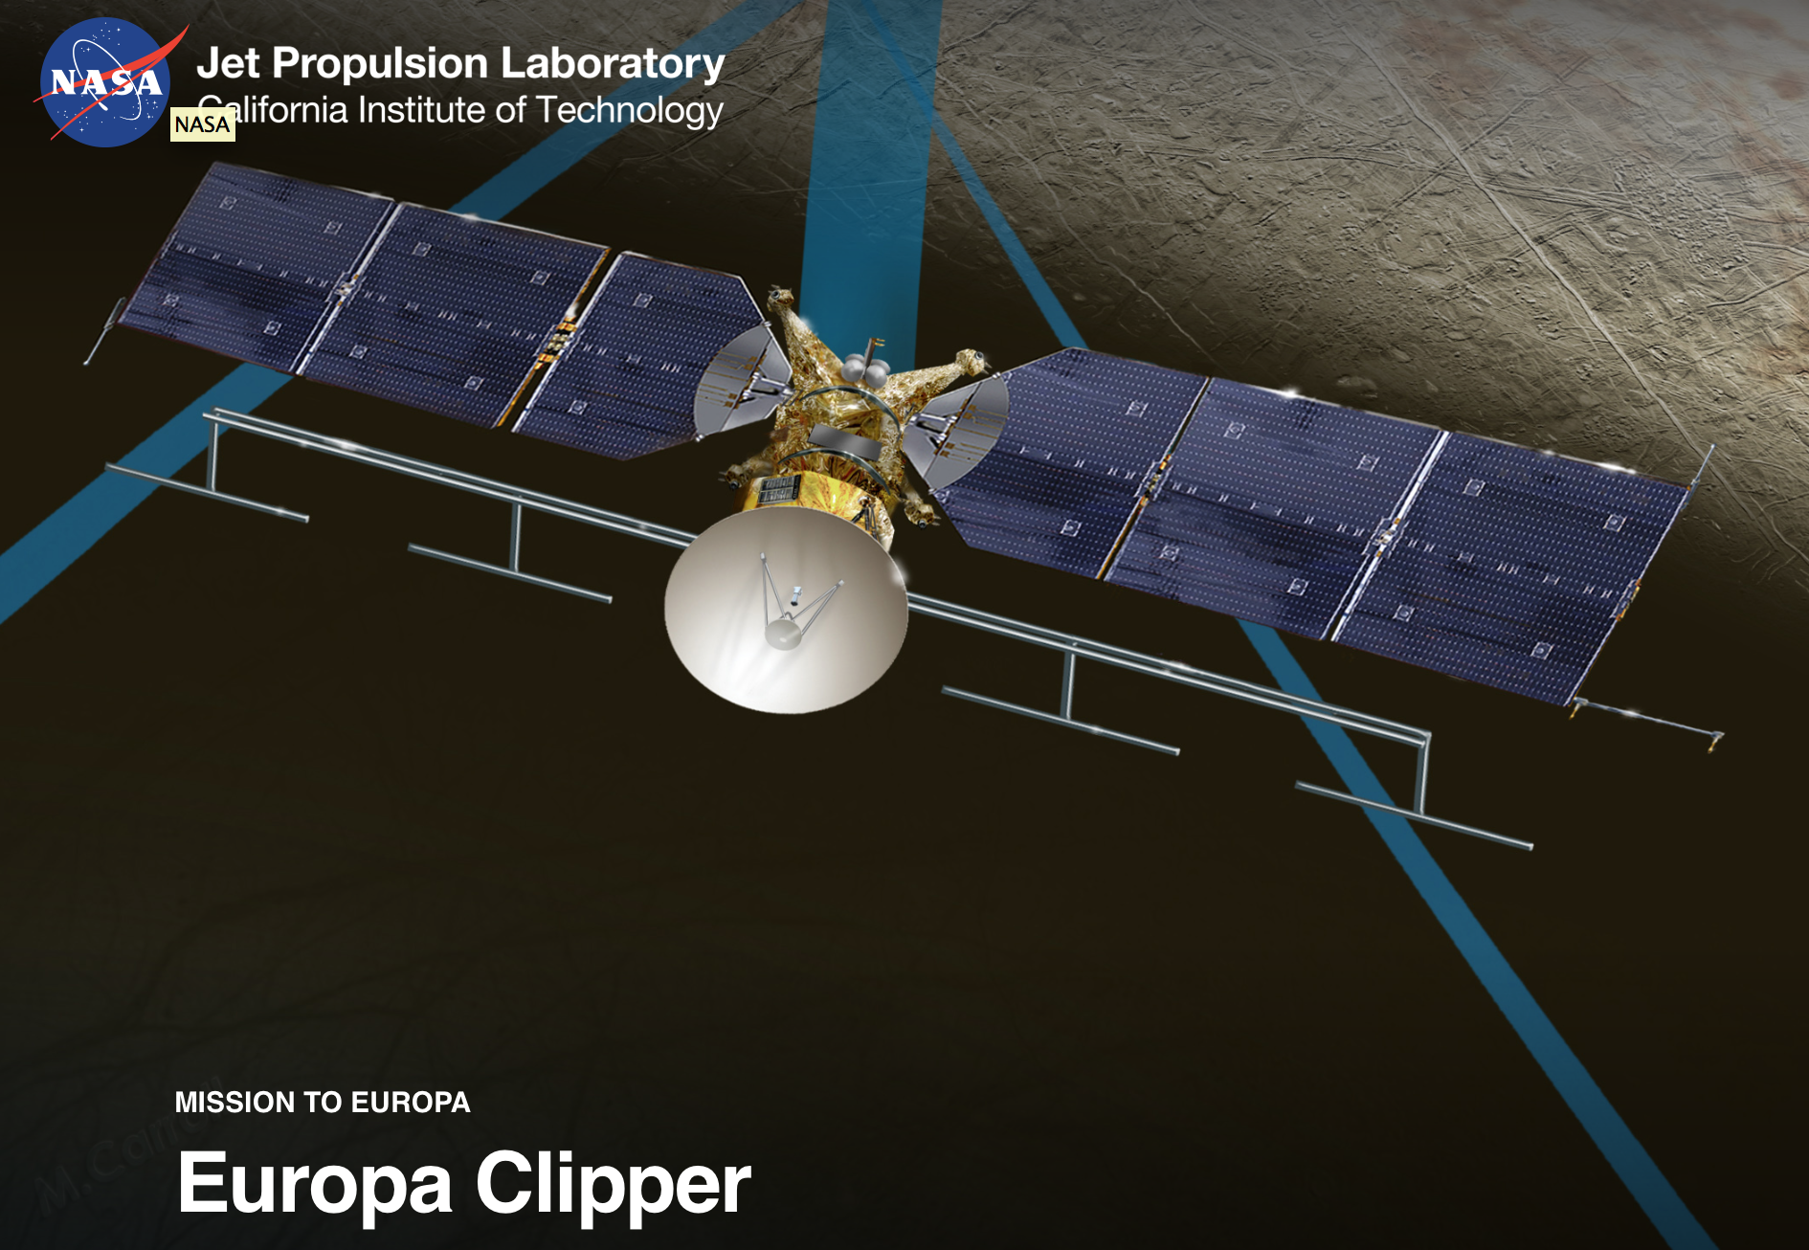
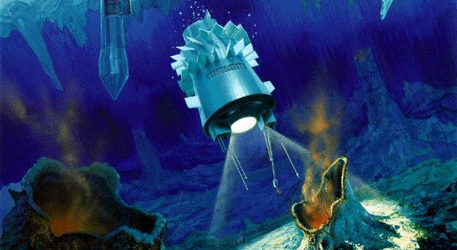
Going to Europa The Europa Clipper mission
Perhaps in some future:

Slide 3


How are missions normally designed?

Slide 4
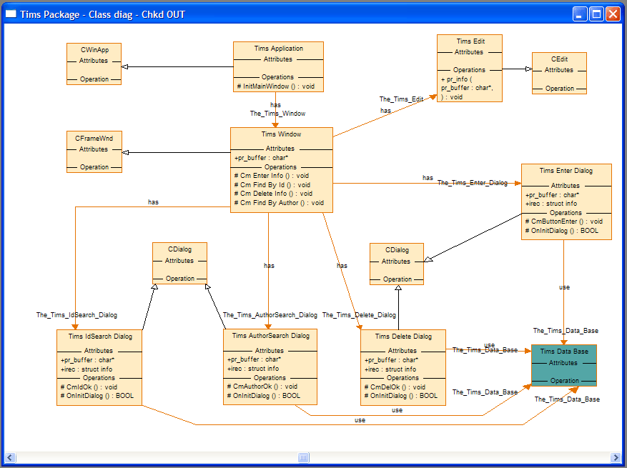

Alterative pursued @ JPL
UML/SysML

Slide 5

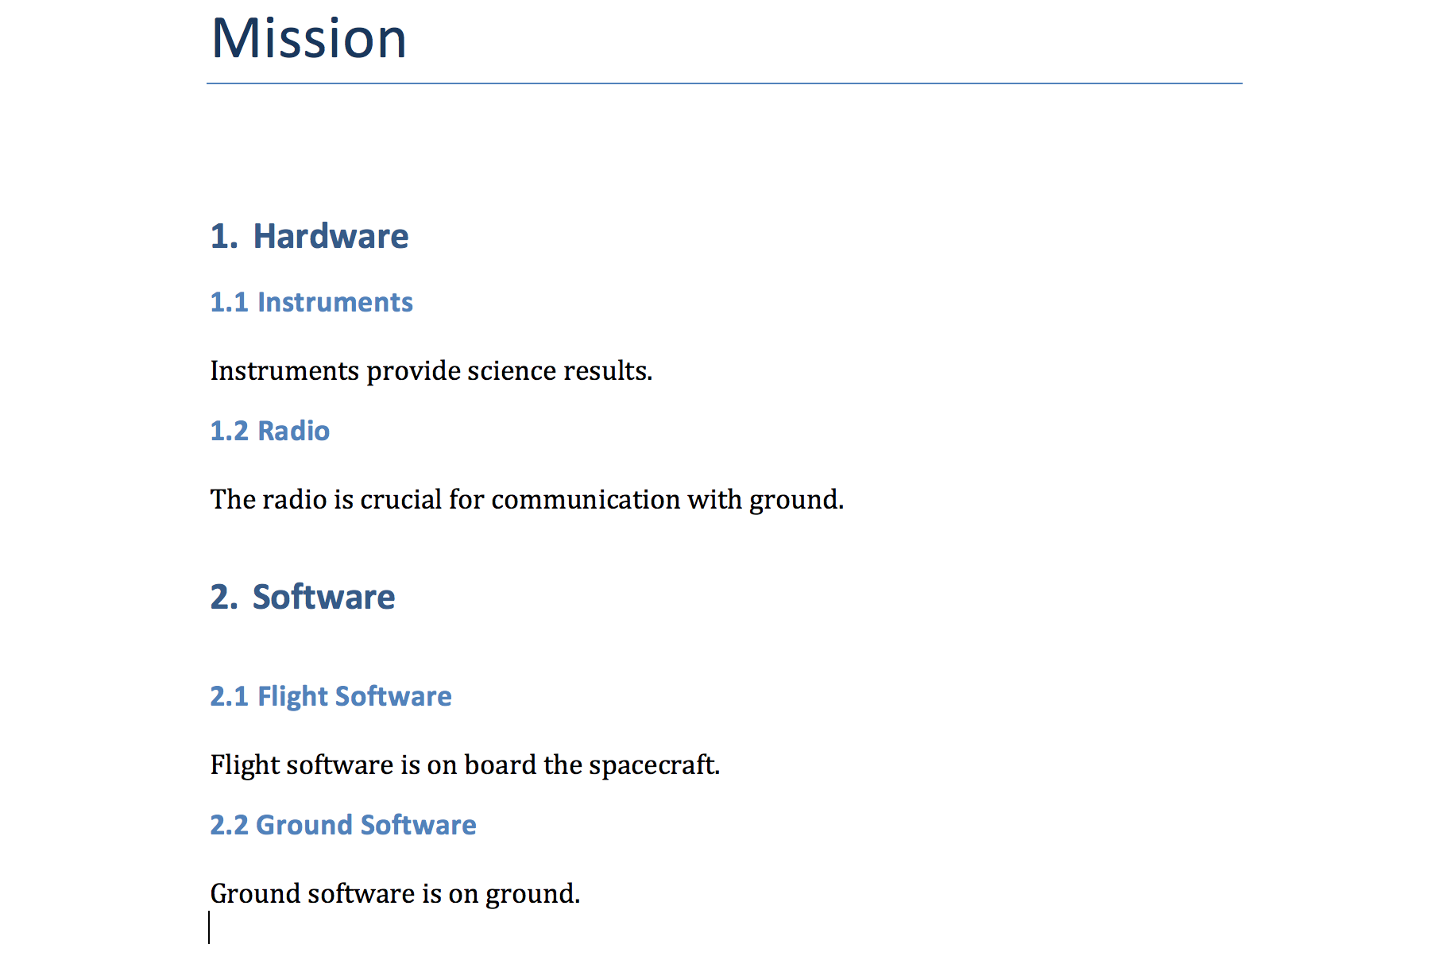
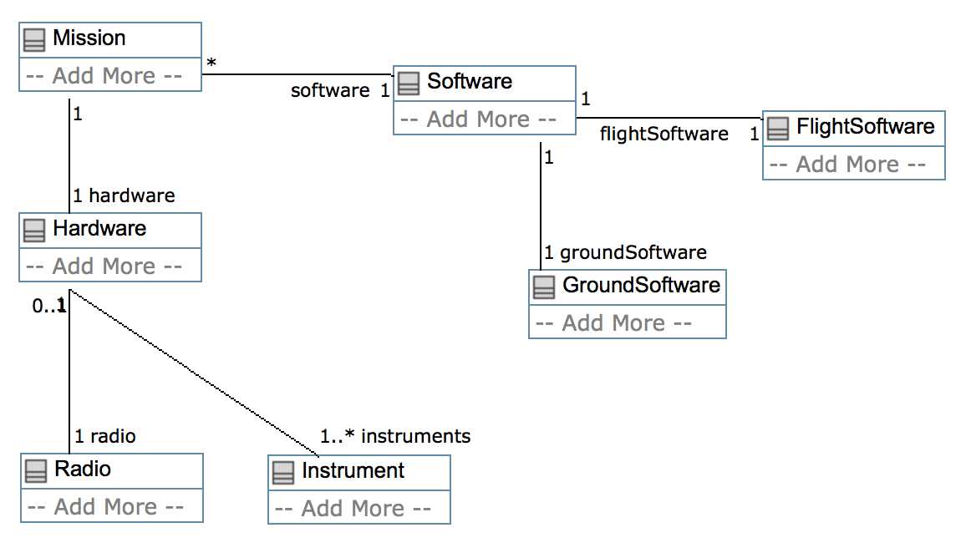
A path to acceptance

Slide 6

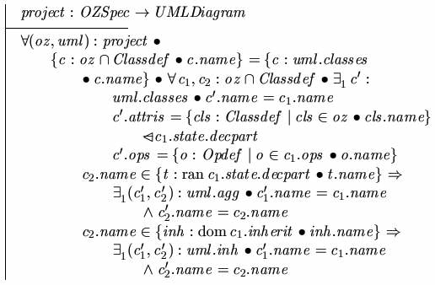
Observation 1
popular:
class diagrams + constraints
Model based engineering community @ JPL
UML, SysML, Visual languages
Semantics difficult to find/use
No analysis
Formal methods community @ JPL
Formal and Textual languages
Semantics clearly defined
Analysis (model checking, th. proving, …)

Slide 7
But the goals are the same
model
Create models
Analyze for correctness
Possibly produce implementation
Verify implementation
implementation

Slide 8
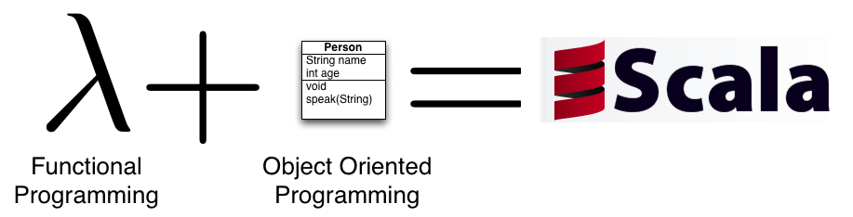
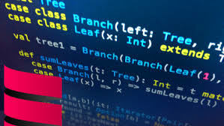
Observation 2
Programming languages
Modern programming languages moving in the direction of spec L.
Combining object oriented and functional programming
Supporting collections, such as sets, lists and maps

Slide 9
Conclusion
+
+

Slide 10
Obvious questions
Why not pick an existing formal specification language?
Why not pick an existing programming language?
Some possible answers
Desirable to own the tool stack, full control over syntax, parser, type checker, analysis support.
Keeping it as simple as possible. Scala is complex, for tool builders and for modelers.
Full automation required. No interactive theorem proving.
But: there is no really good reason for not choosing a programming language like for example Scala.

Slide 11
Modeling as programming
They want to be able to mix modeling and programming, for example by going from requirements to test scripts.
As management pointed out at a presentation:
Most people are been taught programming at some point and will
find it much easier than all this diagramming.

Slide 12
K Language Constructs
Packages
Classes
Inheritance
Properties (fields): Bool, Int, Real, Sets, Bags, Lists, …
Functions (with subtyping)
Constraints
Rich expression language (predicate logic)
Side effects eventually (programming)
Relations
Multiplicities
Annotations
On wish list:
Full reflection: write a static
analyzer for K in K as a library.

Slide 13
Properties
Spacecraft
Class Spacecraft is said to have the property “instruments”.
MBE refers to this as a “relation”
FM refers to this as a “field”
name:String
R
0..1
1..* instruments
Instrument
$$s.instruments=\left\{i :Instrument \right|\left(s,i\right)∈R$$
weight : Int
R

Slide 14
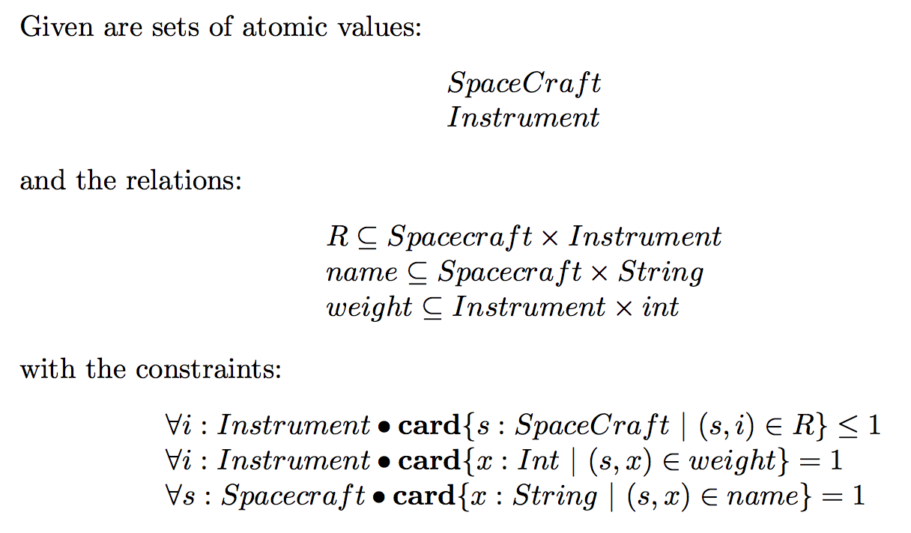
Relational View
Spacecraft
name:String
R
0..1
1..* instruments
Instrument
weight : Int
R

Slide 15
Domains
Domain specific theories encoded as K libraries
Libraries
SysML
Mechanical
Solar system
Europa

Slide 16
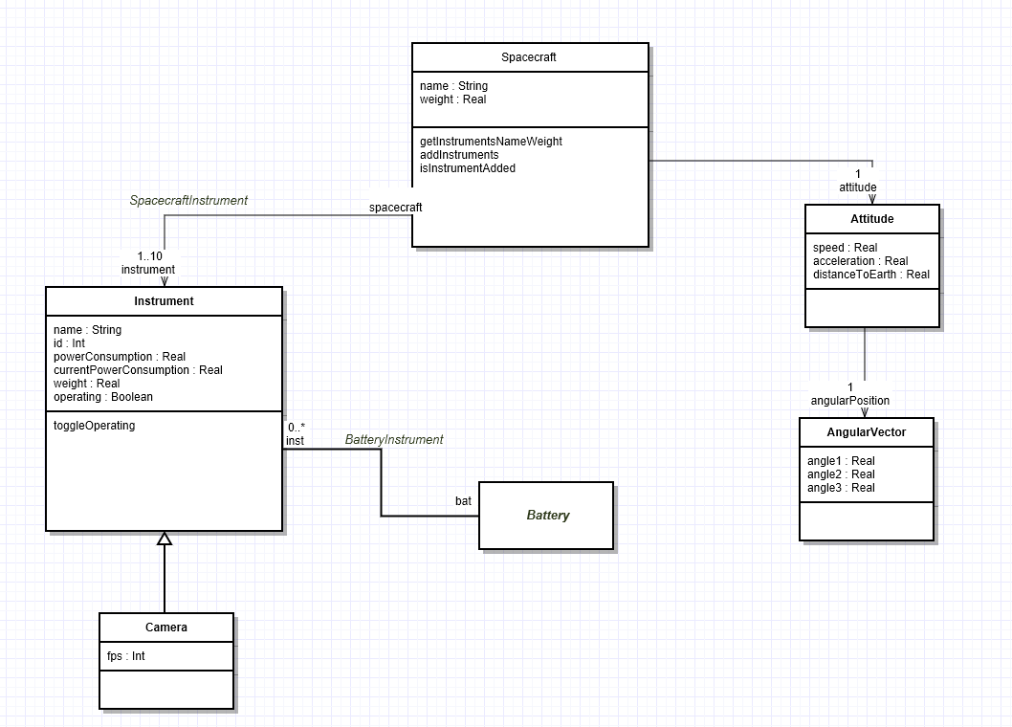
Spacecraft Example

Slide 17
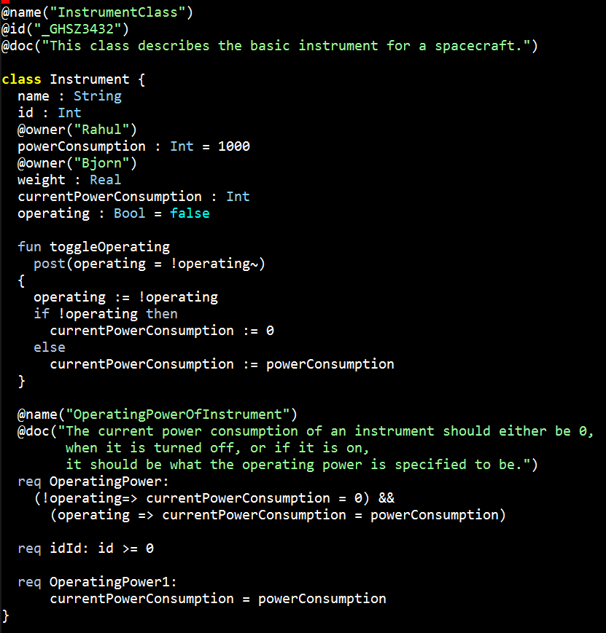
Spacecraft Example

Slide 18
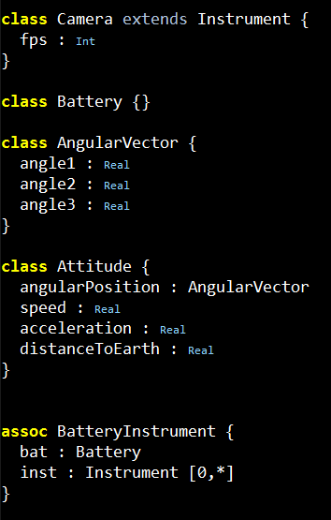
Spacecraft Example

Slide 19
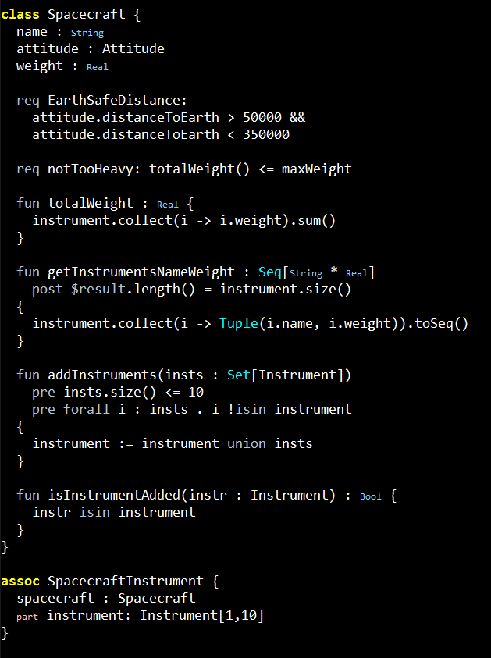
Spacecraft Example

Slide 20
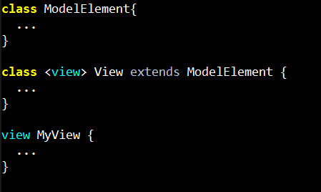
Extensible Keywords
You can use view instead of class.
This is the same as writing
class MyView extends View {

Slide 21
Examples of K models and generated Z3 formulas

Slide 22
A simple planning scenario
a
b
Schedule 1
c
OR
Schedule 2
a
c
b

Slide 23
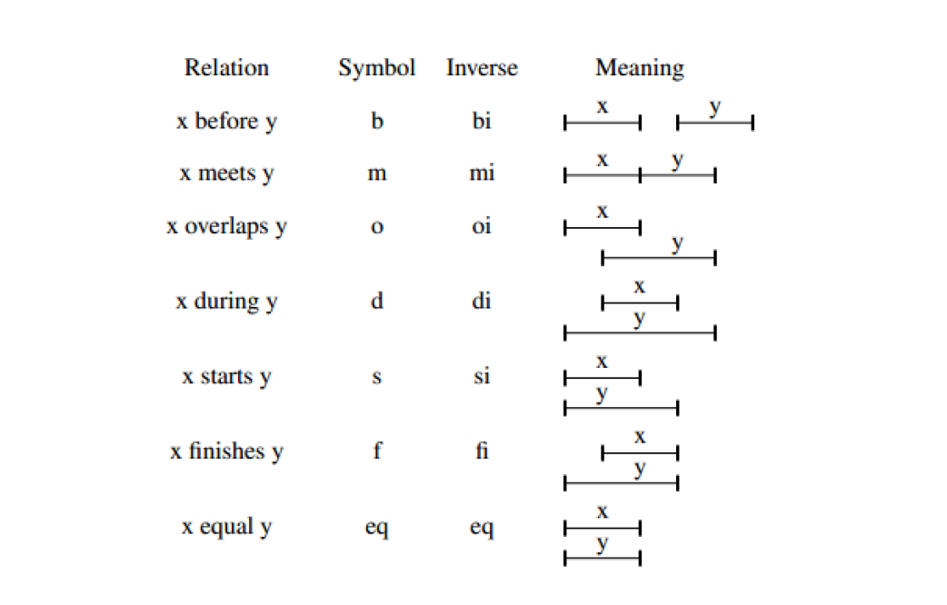
Allen’s interval logic

Slide 24
Further…
Mapping from SysML diagrams (MagicDraw) to K and back
Translation to Latex
Translation to Z3, Mathematica, …
Runtime environment
And … determine relationship to existing programming language(s)
Python is used by even system engineers (solar system model in Python exists)
Java is used all over the place, but mostly by software engineers
Scala would be the closest match from a language point of view

Slide 25
More questions

